Slide 1
Icampus & Academic Notice
Viewer and Notifier
SKKU HELPER
Team 5

Slide 2
Index
Motivation
Goal
SRS 문서화
구현 결과 / 데모
테스트계획 / 결과

Slide 3
Motivation

Slide 4
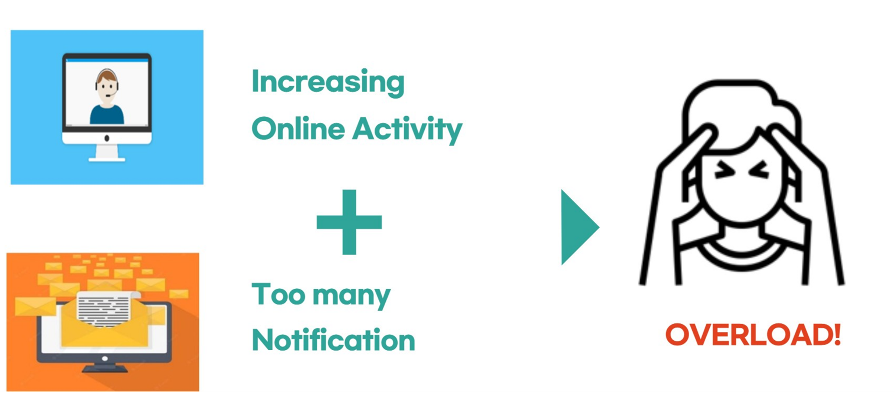
Background

Slide 5


Motivation
Important notices are mixed with unnecessary contents
Department events
Lecture videos
Assignments
Various Notices
Disadvantage of current notice
Kakaotalk sends too much uninterested events
Homepage has poor accessibility
Department events

Slide 6
Motivation
IearningX
Sends too trivial Notifications
Uncomfortable TO-DO Function
LearningX
i-Campus check
Only accessible with chromium browser
Need Log-in to check information
Show only necessary assignments
i-Campus check

Slide 7
Goal

Slide 8
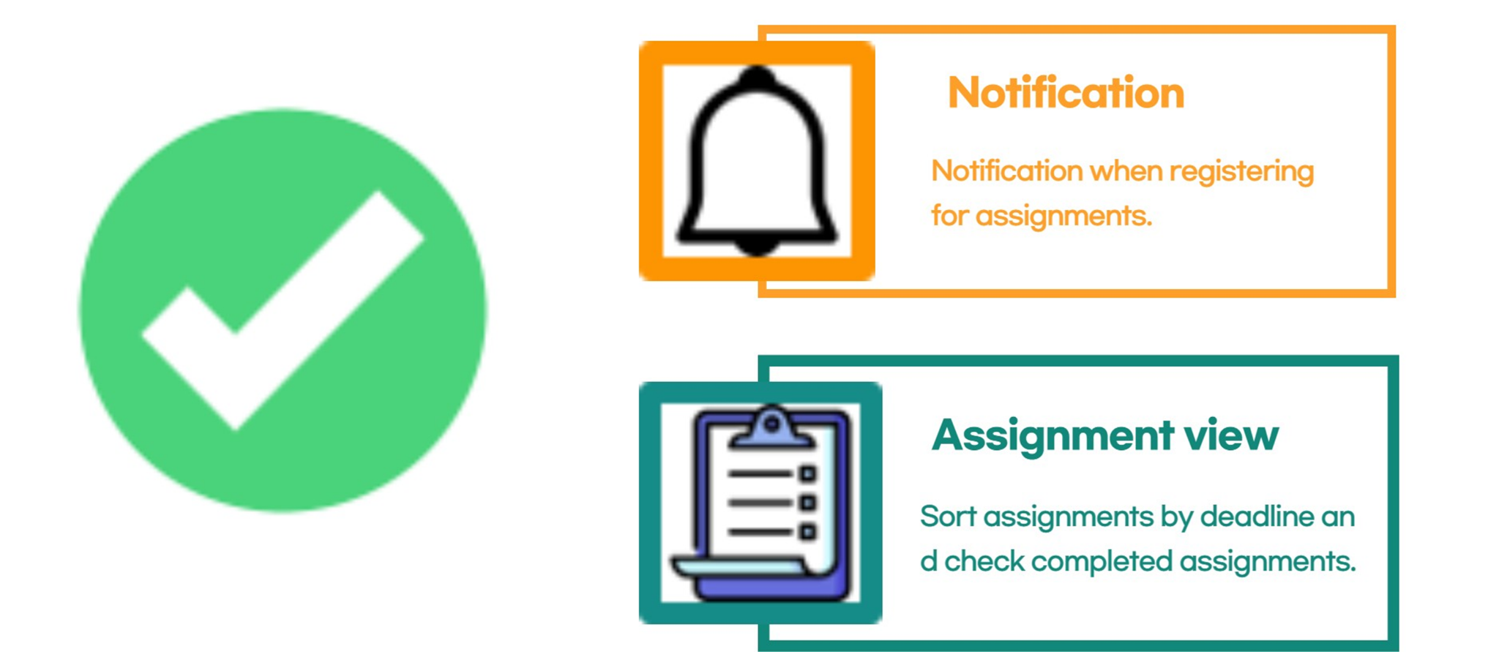
Goal - Icampus

Slide 9
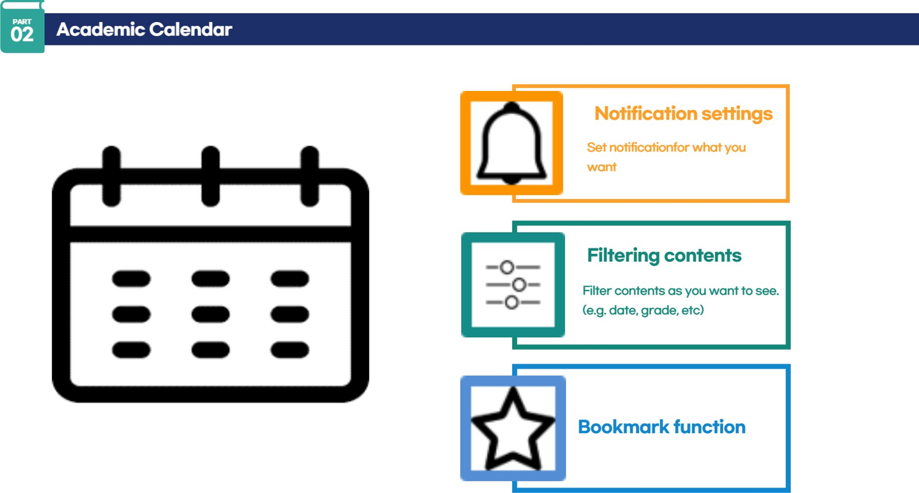
Goal - Academic notice

Slide 10
SRS Documentation

Slide 11
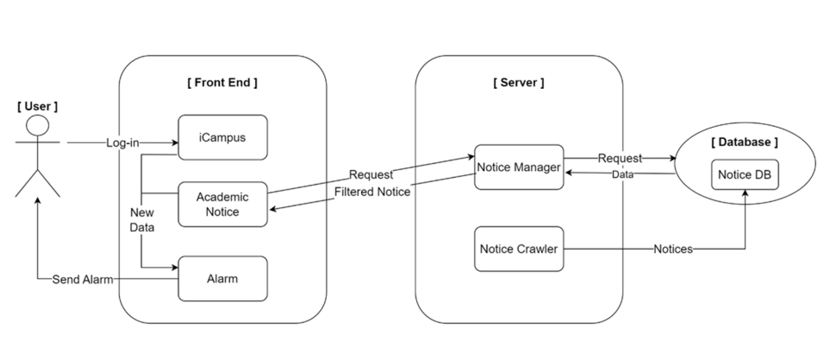
System Architecture
Frontend
Backend
DB server
Notes:
Product functions 소개를 위한 System Architecture에 대하여 먼저 소개

Slide 12




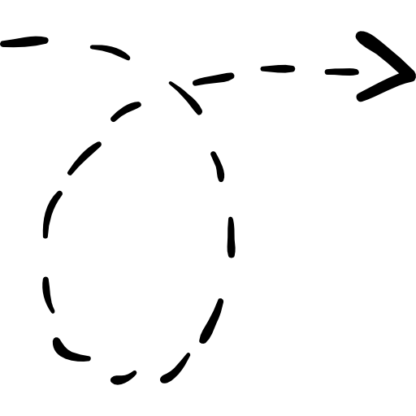


Product Function Frontend
i-Campus
Alarm
All Notices
Academic Notices

Slide 13

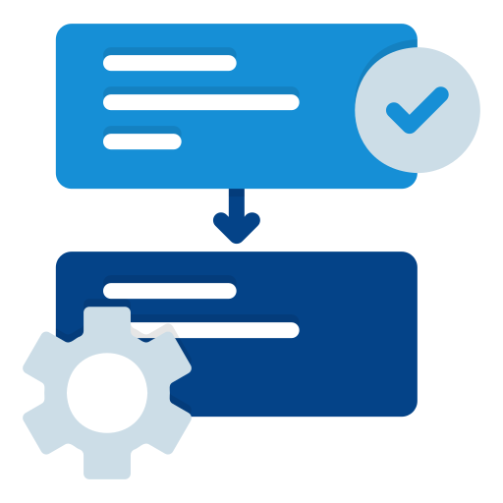




Product Function Backend
Backend
Call API
Check Data
Crawler
Frontend
Data
Notice Manager

Slide 14




Product Function Database Server
Response
Database
Crawler
Request
Notice Manager
Notice document

Slide 15
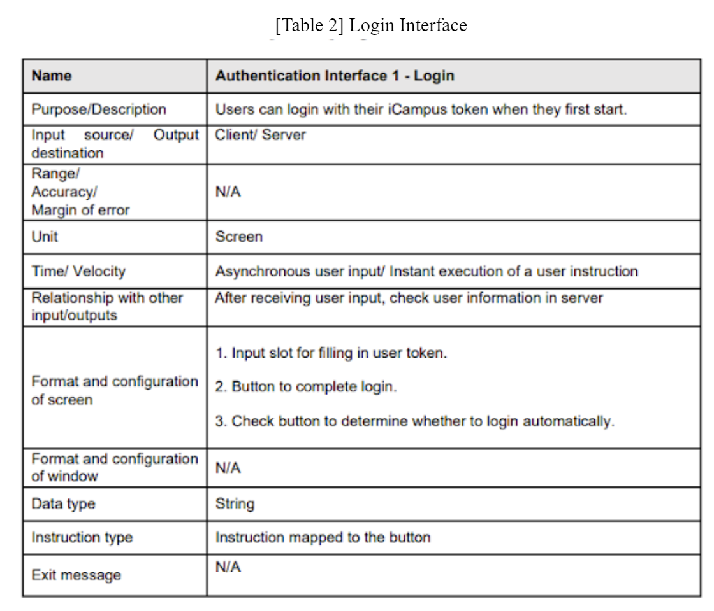
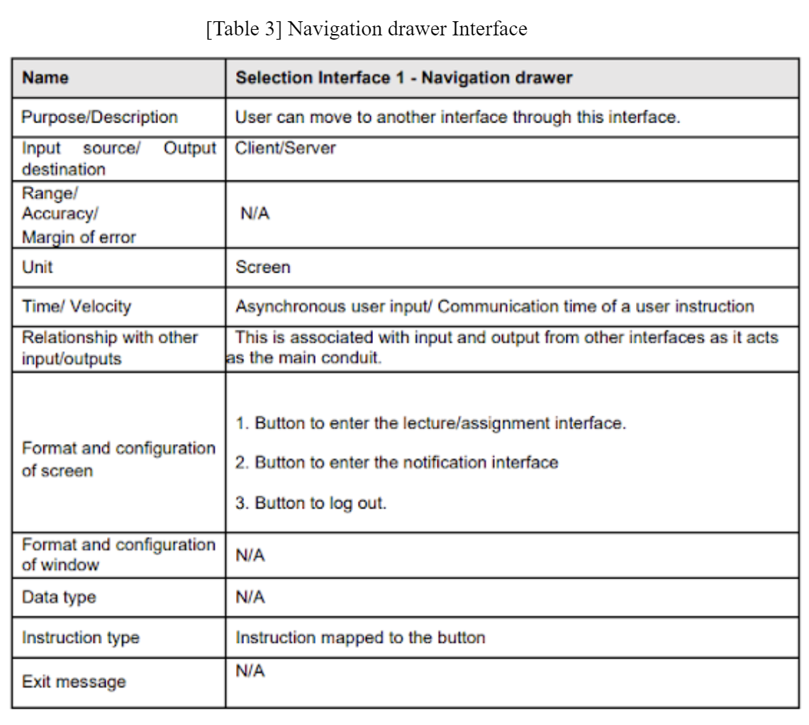
Specific Requirement - User Interface

Slide 16
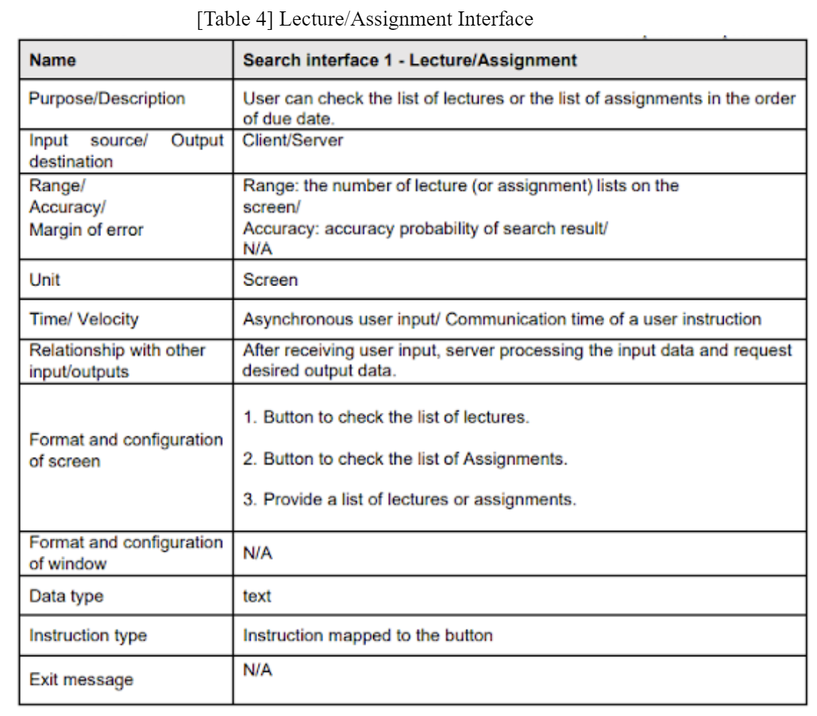
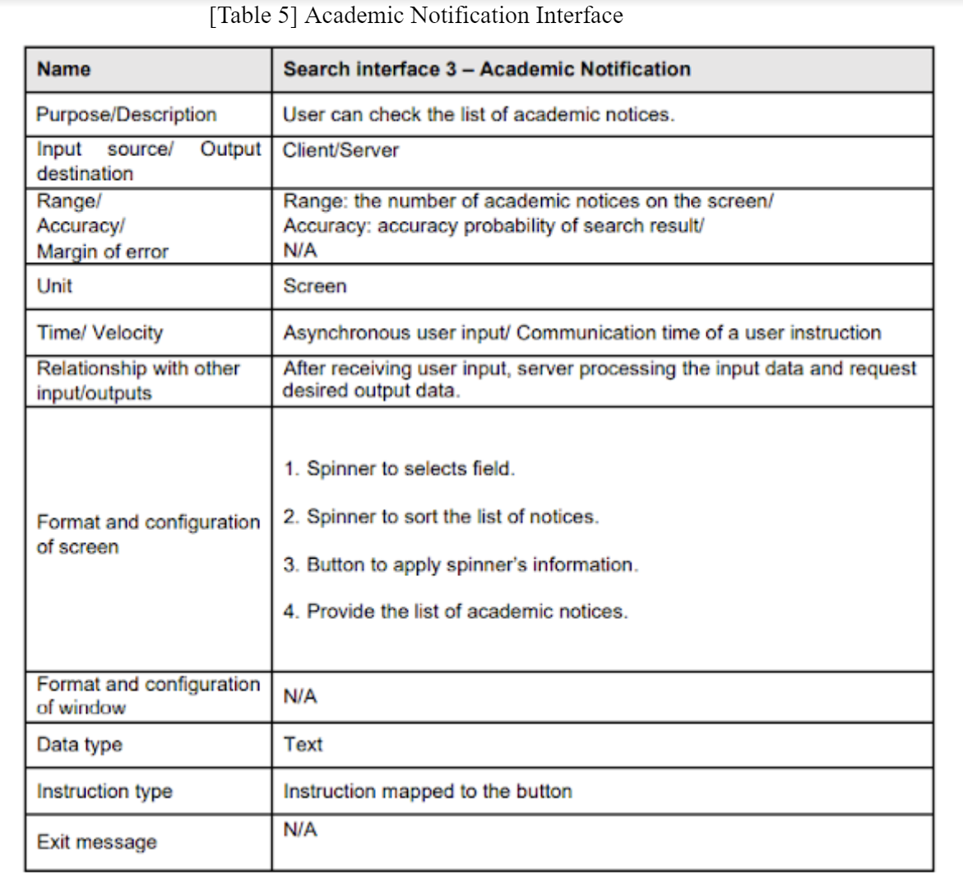
Specific Requirement - User Interface

Slide 17
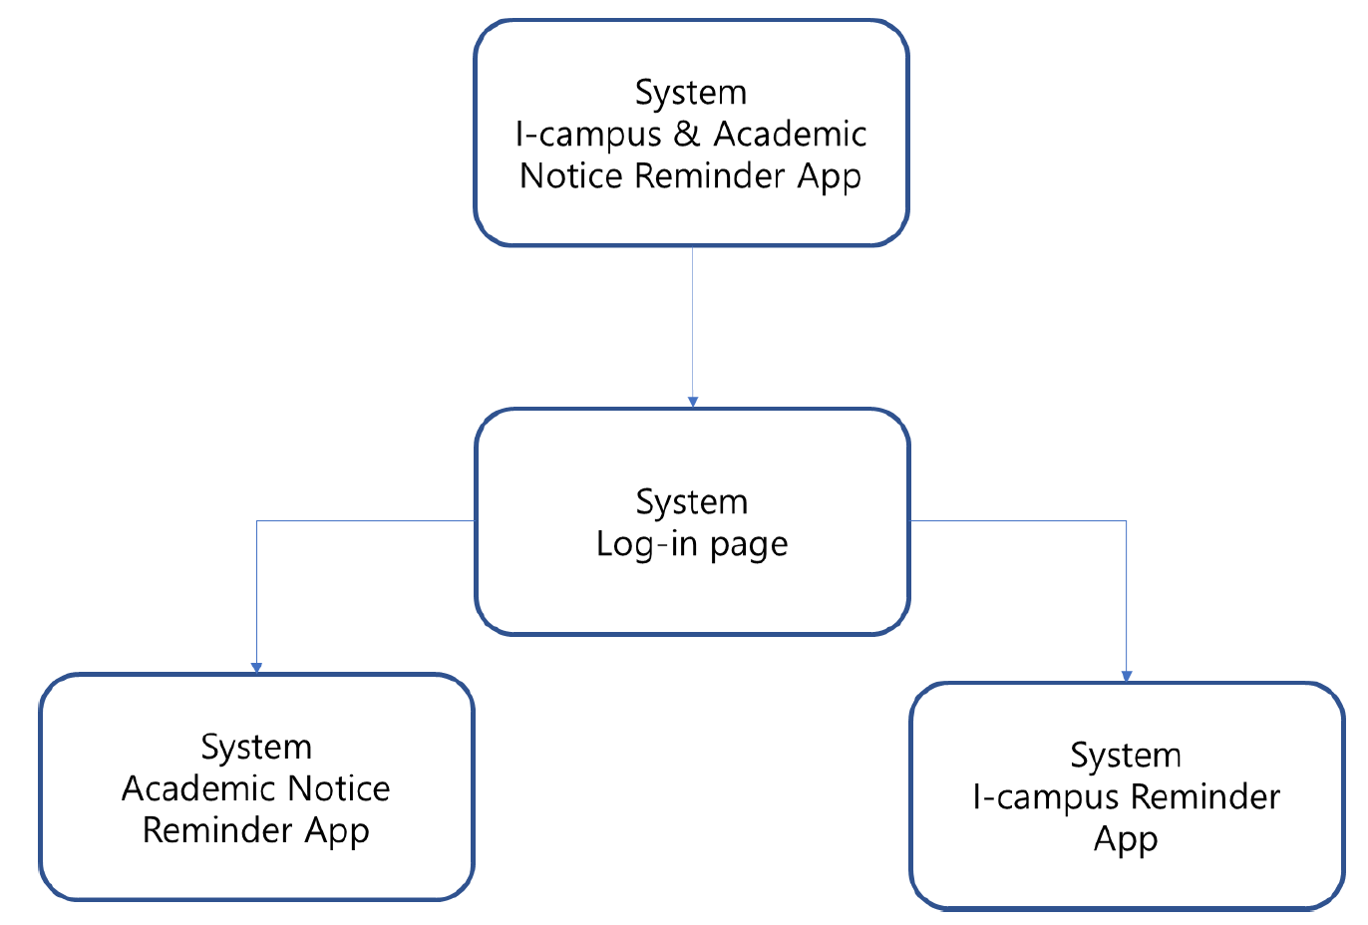
Organizing Specific Requirement
Context Model
Process Model

Slide 18
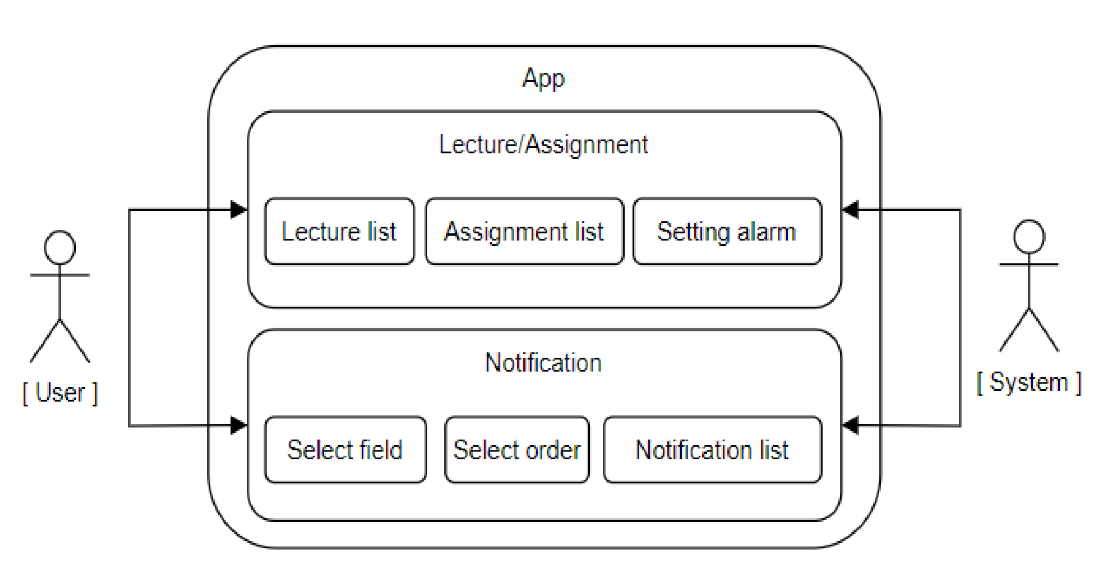
Organizing Specific Requirement
Interaction Model

Slide 19
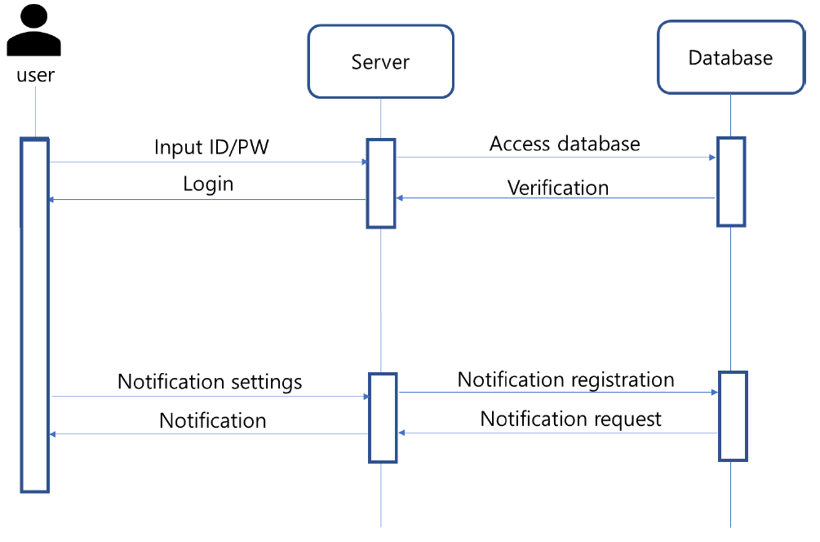
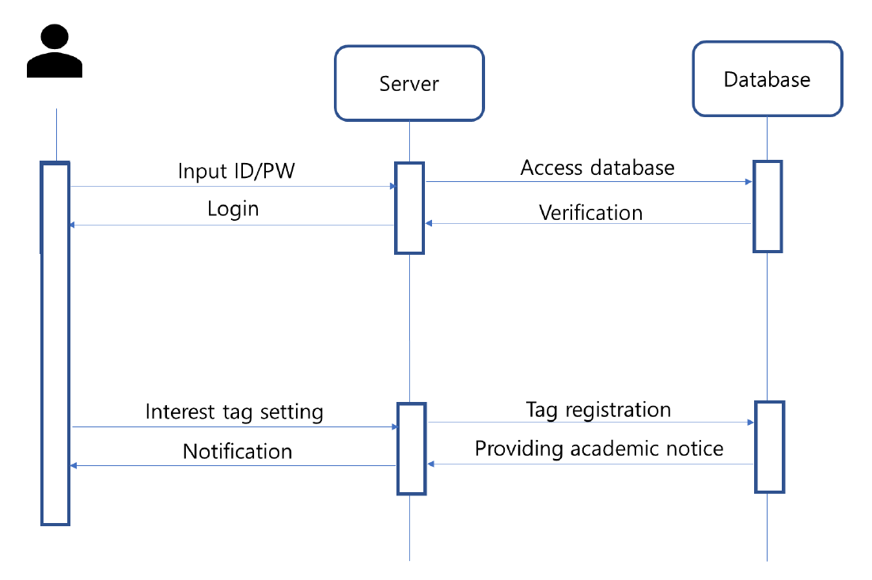
Organizing Specific Requirement - Behavior Model
Sequence Diagram
i-Campus
Sequence Diagram
Academic Notice

Slide 20
Organizing Specific Requirement - Behavior Model
Sequence Diagram
i-Campus
Sequence Diagram
Academic Notice

Slide 21
Requirement
Functional | Academic Calendar | Database The Academic Calendar is connected to the database to deliver the information quickly and accurately. Client/Server System Distributed system in which all the data reside at the server sides and all applications execute at the client sides.
 | i-Campus Notification | Client/Server system
Non Functional |  | Performance Requirement Safety Requirement Security Requirement

Slide 22
Demo

Slide 23
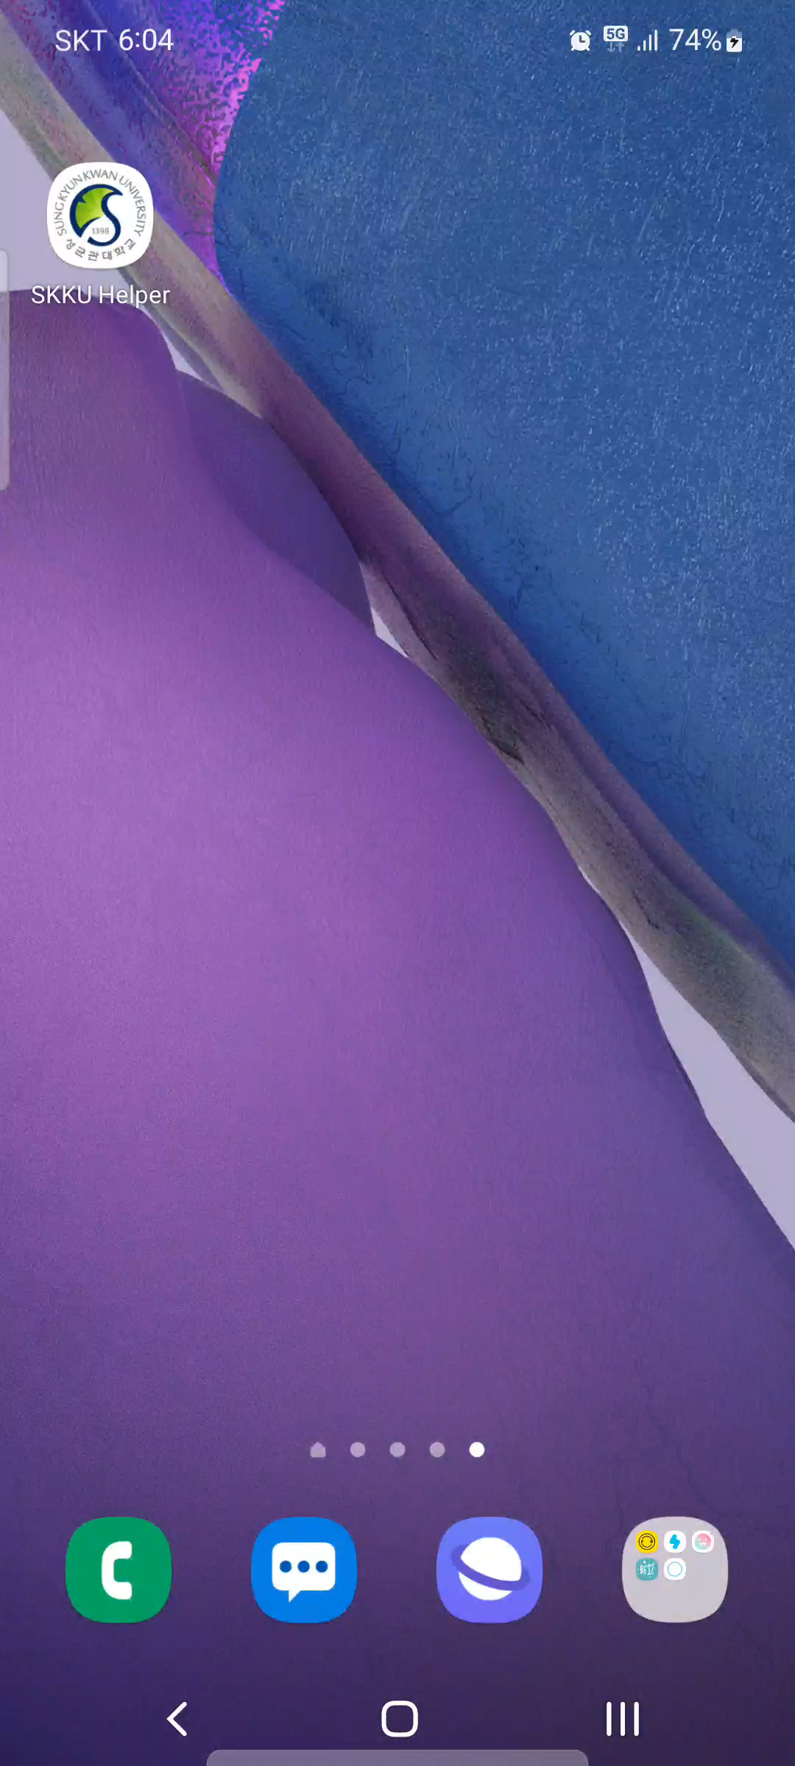
Demo

Slide 24
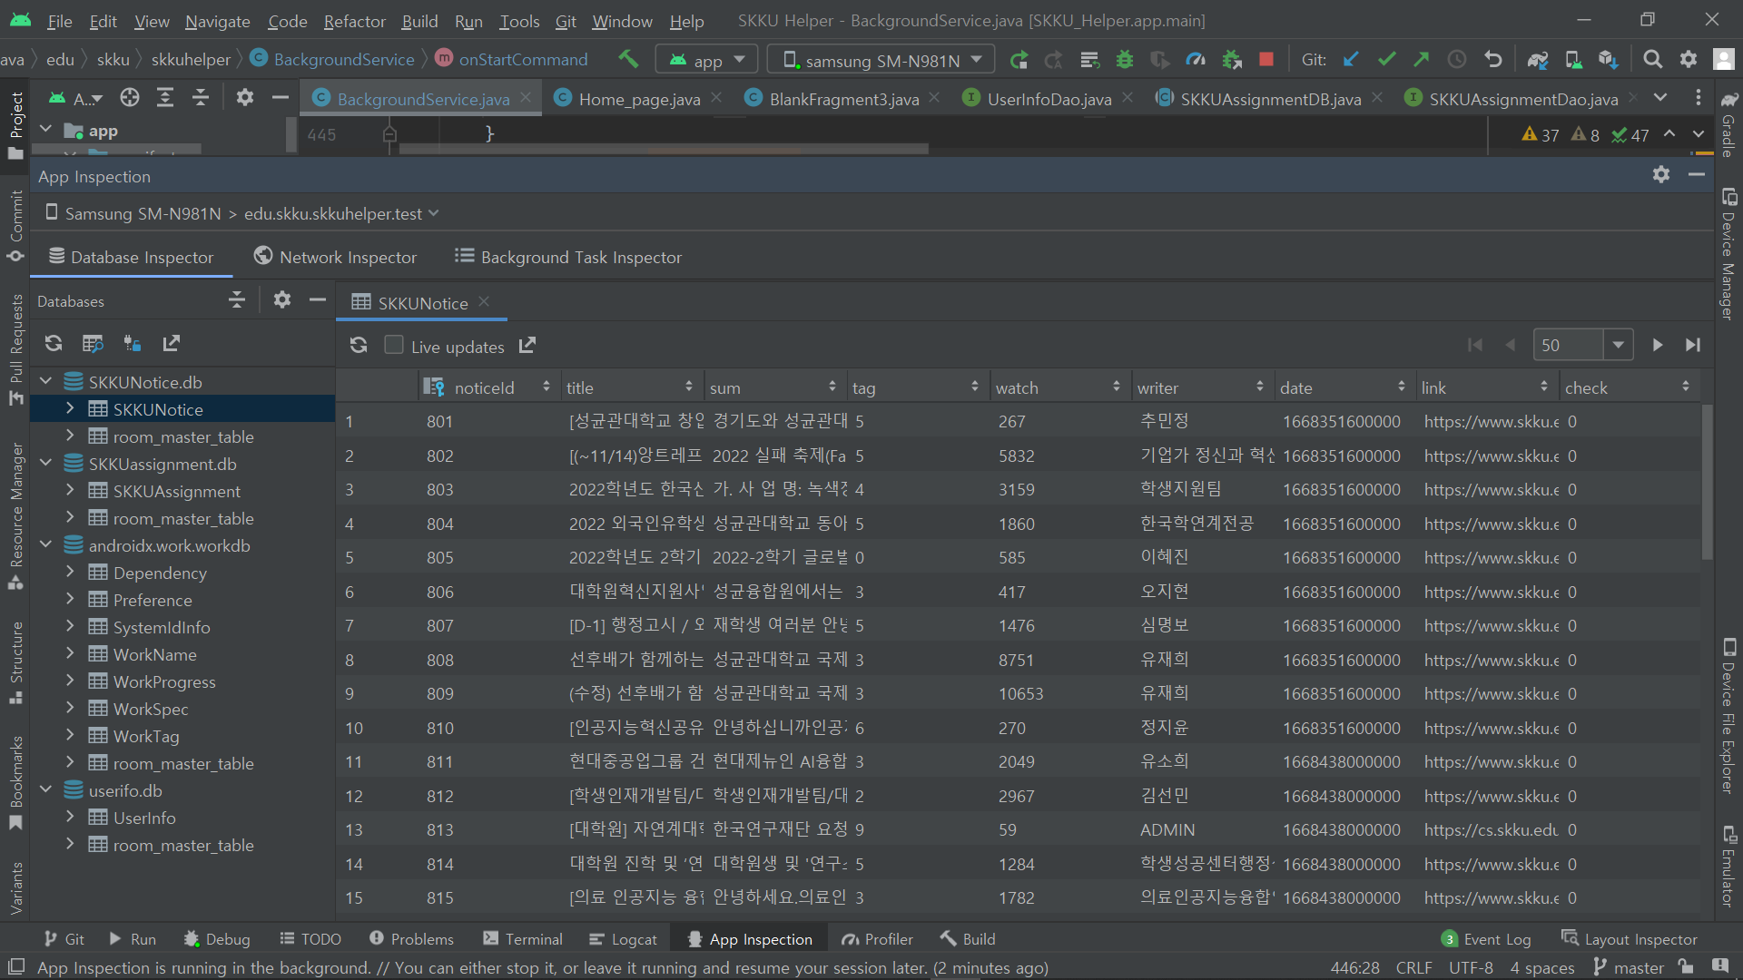
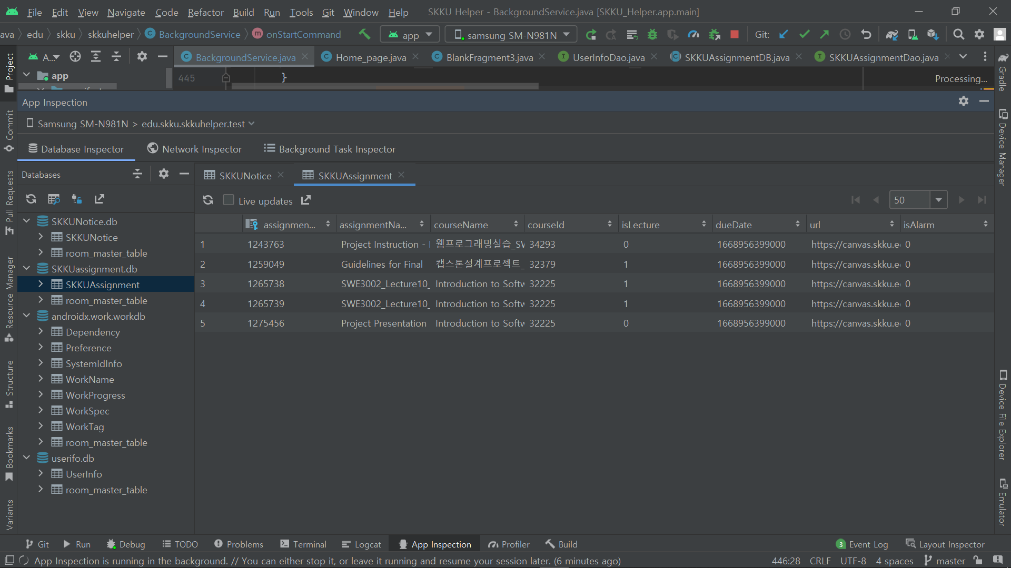
DB

Slide 25
Test Plan & Result

Slide 26
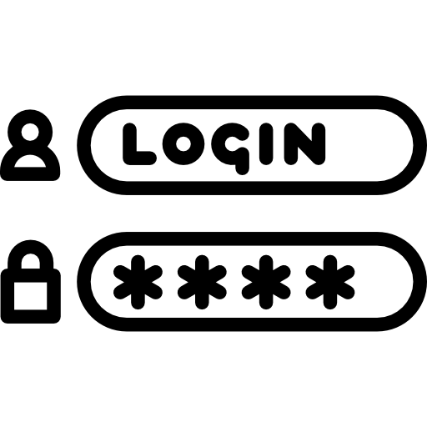






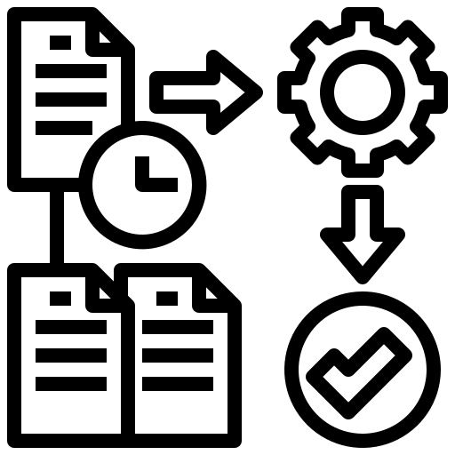


Test Plan - Software Unit Test
Log-in
Go Back
Crawling
Canvas API Call
Database Request
RoomDB
Call Processing Time
Alarm
Background Process
Software Interface
Notes:
10가지 Test Plan 준비

Slide 27
Test Result
Category | Detail | Result
Background | Go - Back | Run
 | Shut Down | Fail
 | On - Off | Run
 | Canvas API Call | Run
 | Notice Server Call | Run

Slide 28
Test Result
Category | Detail | Result
Canvas API | Call all assignments | Run
 | Call all lectures | Run
Running Time | Read all assignments | Run
 | Read all lectures | Run
 | Data processing | Can’t check

Slide 29
Test Result
Category | Detail | Result
RoomDB | Create/Read/Delete User | Run
 | Create/Read/Delete/Update Lecture | Run
Alarm | Alarm Setting | Run
 | DB updating | Run
 | Running in time | Run

Slide 30
Test Result
Category | Detail | Result
Call Notice | Call notice by User | Run
 | Call notice by User - Negative | Run
DB Sever | Check Summary of Notice obtained through crawler | Run
 | Check Summary of Notice obtained through crawler - Negative | Run
 | Delete&Update summary of Notice obtained through crawler | Run

Slide 31
Test Result
Category | Detail | Result
Login | Login test - positive&negative | Run
Navigator | Go menu tab | Run
 | Check user information by token positive&negative | Run
Back | Click back button twice, off the app positive&negative | Run

Slide 32
Test Result - Interface Test
Category | Detail | Result
Notice Crawler | Get crawler end time | Run
 | Check Running regularly | Run
Alarm | Lecture alarm Test | Run
 | Assignment alarm Test | Run
 | Notice alarm Test | Run

Slide 33
Test Result - Interface Test
Category | Detail | Result
Login | Approval time | Run
 | Approval time - Negative | Run
 | Auto Login | Run
 | Logout Test | Run

